Slide 1
Medical Search Engine
Project No: 24
Group No: 13
Presenting by,
Nilotpal Pramanik (IRM 2016501)
Anand Singh (IRM 2016007)
Mohit Verma (IIT 2016112)
Under Supervision: Dr.Ranjana Vyas, Dr.O.P.Vyas
Associated TAs: Ms.Divya, Mr.Anant

Slide 2


Introduction
According to our B.Tech-4th Semester DBMS(432C) projects Project no:24, having title “Medical Search Engine” was assigned to us(Group-13).

Slide 3
1.
Abstract of the Project
Let’s start with the abstract...

Slide 4
This application is a simple “mobile application” which enables user to get information about symptoms of a disease and list of medical shops where user can find the medicines.Simple UI helps Users to find the information required.More informations about a disease, symptoms and medical shops can be added by simply adding entries in the database.

Slide 5
2.
Specific Technology can be used
Now go for the related tools...

Slide 6
myPhPAdmin (for Database)
Java (for Backend)
XML (for Frontend)
Android Studio (for making the App)
JSON for DB Connectivity

Slide 7
3.
Project Tasks
Here is the all performed and verified tasks...

Slide 8
Draw ER Diagram
Schema of each tables
Normalize all the table upto 3NF
Implementation Task
User Interface

Slide 9
IDEA CONCEPT
In the Android App “MediCare” we are taking the all the necessary details of the user to register to the app and there the user can search about any diseases to find its corresponding Symptoms,Medicines along with its Price and Nearest Medical Stores.

Slide 10
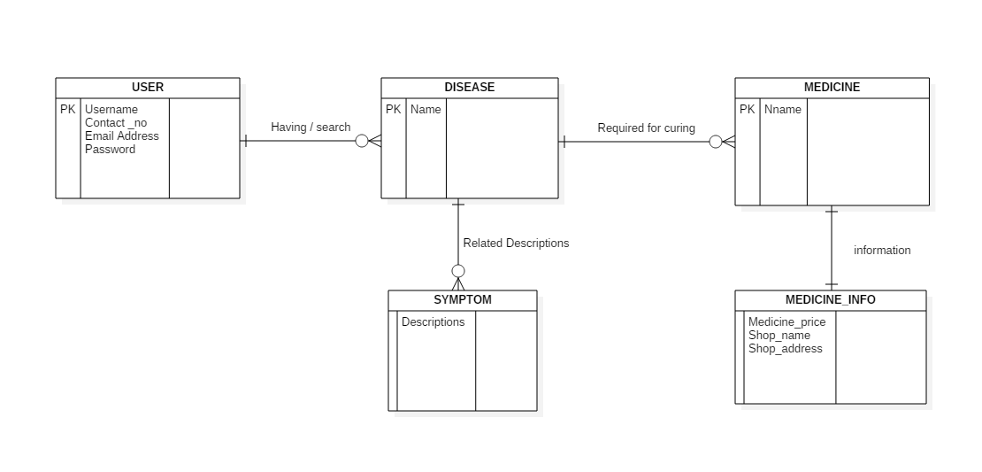
Entity Relationship Diagram
10

Slide 11
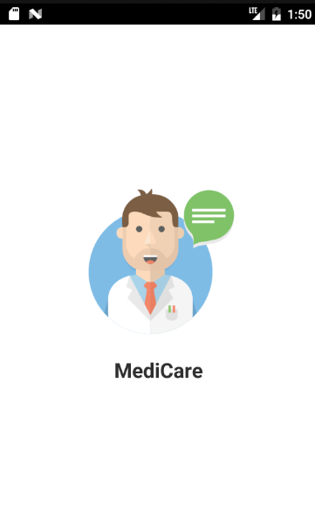
Welcome Page
Using Splash it has been created with 5s time duration to load.
Place your screenshot here

Slide 12
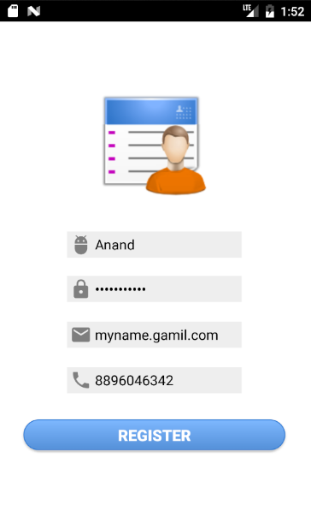
Register Page
There the user have to fill all required informations(User-Name, Password, Valid Email, Valid Phone Number) to be Registered in the app.
Place your screenshot here

Slide 13
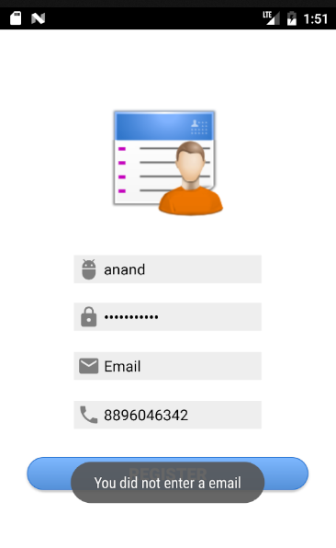
Authentication
If the user forgot to enter any of the informations it’ll pop up the unfilled spots and doesn’t allow the user to proceed.
Place your screenshot here

Slide 14
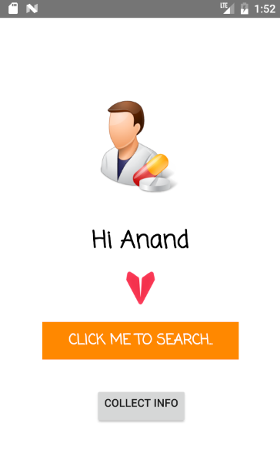
Enter for Searching
Here we are extracting the name of user, which was entered by the user during registration and requesting the user to click the button to got the search page.
Place your screenshot here

Slide 15
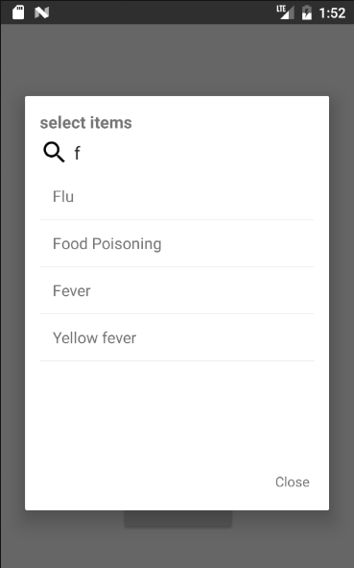
Search Page
Here user can search the disease and it will be searched according to the “letter” entered by the user.And by clicking on the name -> collect info button one will reach to the next.
Place your screenshot here

Slide 16
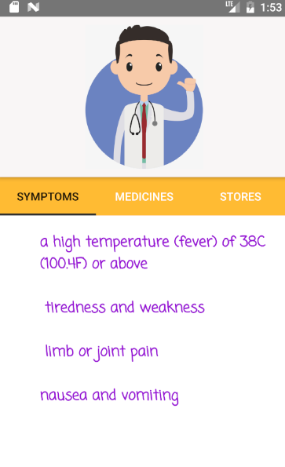
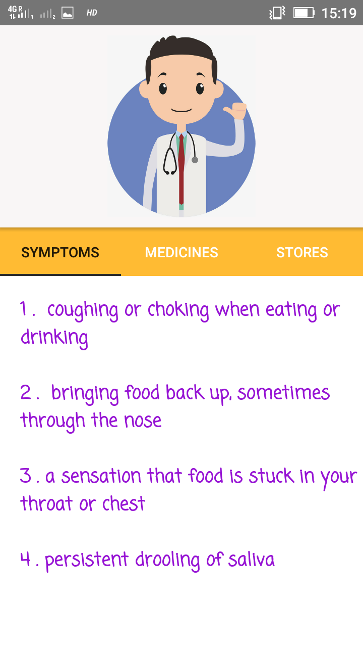
Symptoms
Here user can finds the Symptoms of the corresponding searched diseases.
Place your screenshot here

Slide 17
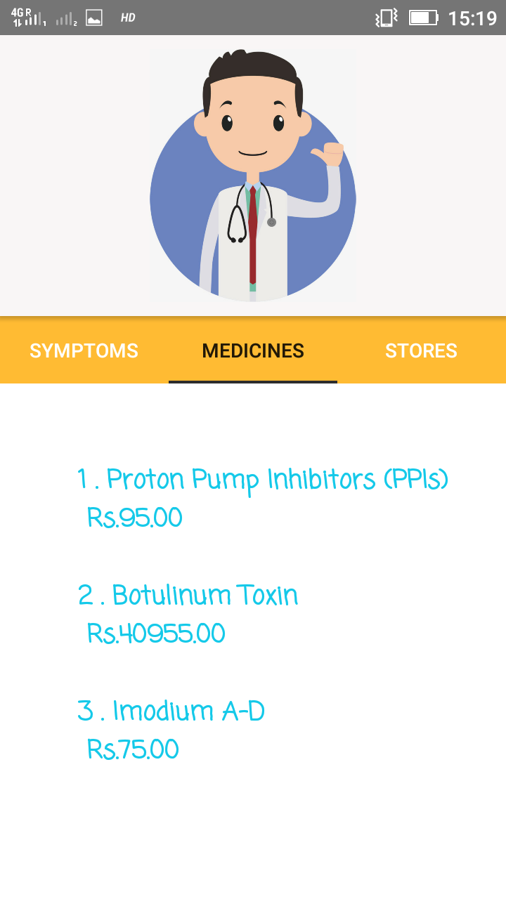
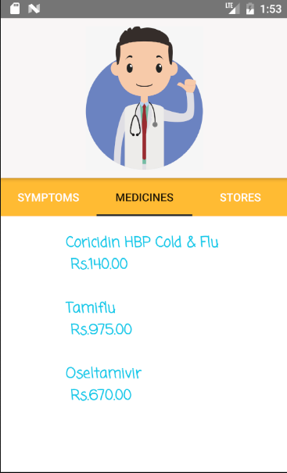
Medicines
Here user can finds the Medicines with price of the corresponding searched diseases.
Place your screenshot here

Slide 18
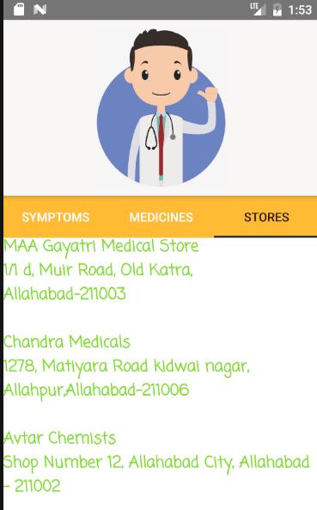
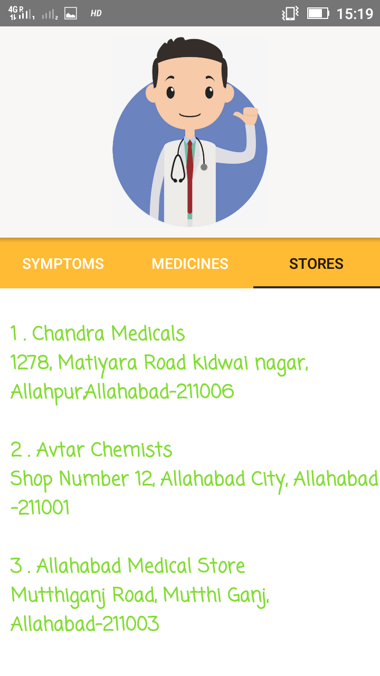
Medical Stores
Here user can finds the Nearest Medical Stores of the corresponding medicines through searching diseases.
Place your screenshot here

Slide 19
References:
Android Studio Manual
DBMS
My Php Admin Manual
Class-Lab References

Slide 20


THANK YOU:)

